Slide 1

What is linguistics research?
LIN 211 • Spotlight 1

Slide 2
The course is structured around questions
What is linguistics?
What is language?
How many languages are there?
Where does language come from?
Spotlight Lecture: What is linguistics research?
What is a word?
How do words get their meaning?
Is slang legit?
Why are some words “bad words”?
Who says “pop” and why?
Where do dialects come from?
What is the prettiest language?
Spotlight lecture: What methods and ethics of inquiry are used?
How do kids learn to talk?
How does bilingualism work?
Why is it hard to learn other languages?
How is writing different from speaking?
🤷
Why can’t Siri pronounce my name?
How do computers help with language?
Are chatbots real?
Spotlight lecture: How do we find relevant linguistics sources?
Are actors good at dialects?
Can you make your own language?
Do animals use language?
Who really uses this stuff?
Why Linguistics?

Slide 3
Making questions approachable
Week 1 lecture and recitation: What is linguistics?
?? what is language?
?? what types of language are objects of inquiry?
?? what can language variation look like?
?? how do/can linguists and non-linguists talk about language?
?? what do people believe about linguistic rules/expectations?

Slide 4

Goal #1: assignment prep
Prepare for future projects in the course
Midterm project: data collection
Final project: thinking about data collected
Ask a research question ⟶ Spotlight 1 (linguistics research + questions)
Propose methods ⟶ Spotlight 2 (methods and ethics)
Find a relevant source ⟶ Spotlight 3 (finding sources)

Slide 5

Goal #2: being curious
Move away from “Getting Started”
How can I apply course concepts?
What’s involved in starting (linguistics) research?
How do I use concepts to make richer observations?
What are the qualities of a fruitful (linguistics) research question?
How could I turn observations into questions?

Slide 6
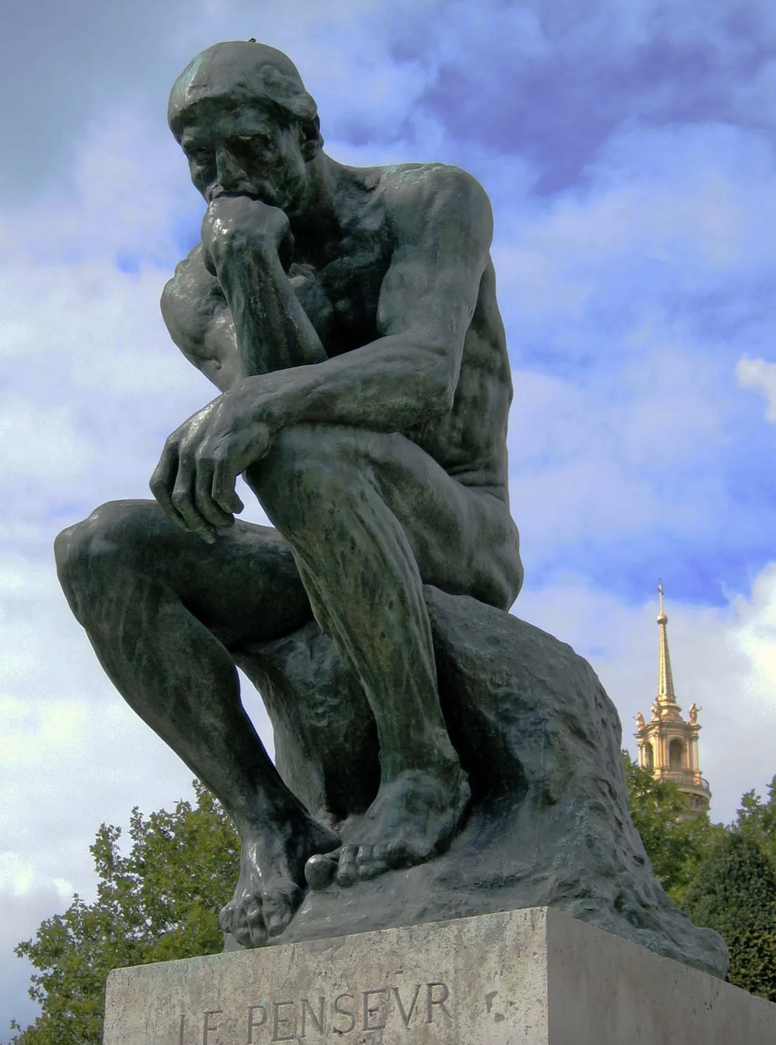
Ling-link...
Spend 1-2 minutes jotting down questions(s) that you’ve had about language
General (“do animals have language?”) or specific (“why does my grandma say warsh?”)
Spend 2-3 minutes talking with your neighbor(s) about your inquiries
Have you all had similar questions or ideas?
How might you go about answering your question?

Slide 7
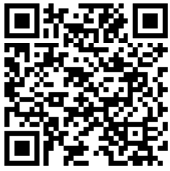


Slide 8
Questions come from observations
“I talk differently when communicating to my friends than my professors”
How does language influence identity?
“People complain about texting ruining how people speak”
How do computers impact modern language?
“[company] said that Southerners sound unprofessional when they talk”
How do people feel about how others speak?
“People have vastly different experiences but can understand each other”
How can people process speech?

Slide 9
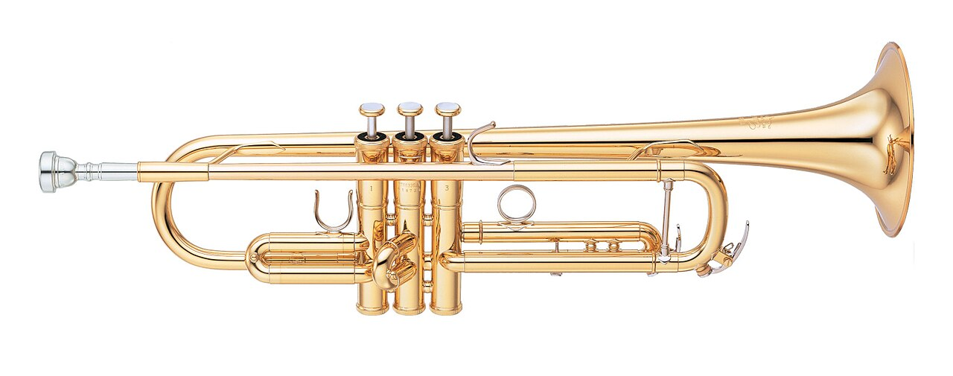
How would we find out?
Research!
Notes:
Imagine that you have questions like the ones that you have on the board
How could we know?
Commit to an answer
Look it up → many questions for which we know the answer but so many more that we don’t know the answer to

Slide 10
What’s involved in research?
Finding plausible explanations for questions
Many ways to approach doing research
Asking a research question
How do I ask a question?
How do I know what questions I can be asking?
Selecting an appropriate method
What are methods?
How do I do research ethically?
Contextualizing
How do I find sources to support my research?
Notes:
Planning ahead

Slide 11

Qualities of solid research questions
Based on previous research
Why: connect to other studies
Are practical
Why: need to be doable
Are specific
Why: more specific = more precise answers
Notes:
Coherent collection of research helping us understand phenomena happening in the world that our field studies’
Time and money and possible at all
More targeted = more specific

Slide 12


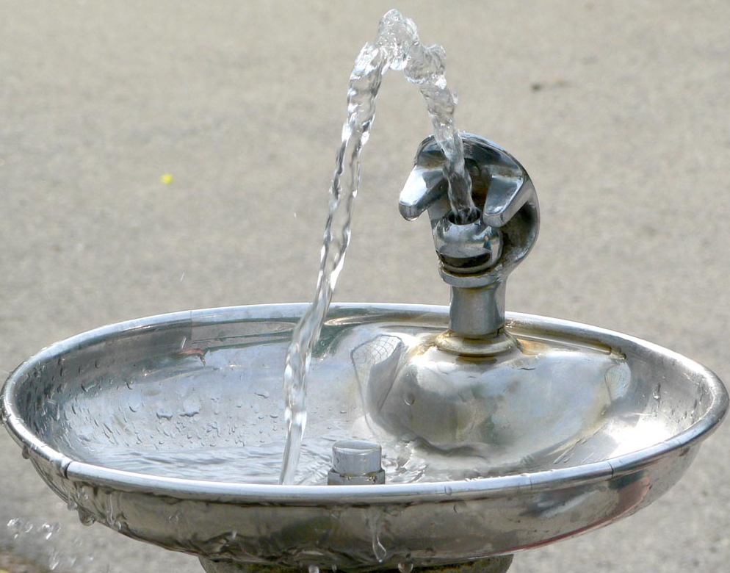
Where does/can research start?
Something that we observe, read about, find interesting, find confusing, find controversial, etc.
For the final project: midterm data + semester content
“I noticed that someone uses bubbler to refer to a water fountain... I wonder what other words might vary between people...”
“I heard someone claiming that bubbler and water fountain refer to the same thing, but I wonder if other people think about them differently...”

Slide 13
Starting with observations (from Recitation 1)
Other examples of regional variation
Pop, soda, coke
lightning bug, firefly
Roly poly, potato bug, pill bug
Including different pronunciations
Wash vs. warsh
pin = pen, pin ≠ pen
Caramel (2 vs. 3 syllables)
People speak differently
In what ways? Why? What effects does this have on how people interact?

Slide 14
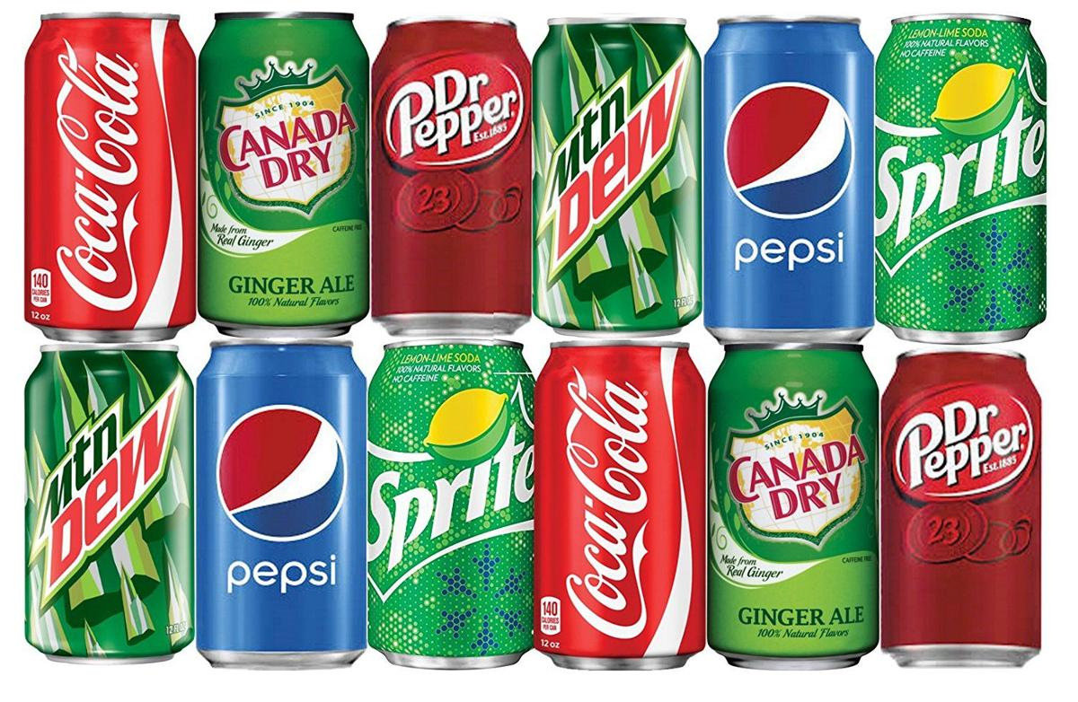
Observations ⟶ questions
Too broad: how does regional identity influence lexical variation?
☞ More optimal: where do people use different words for a carbonated beverage?
what type of lexical (=word) variation?

Slide 15
Attendance question 9-14 (lecture day 6)
What object with regionally varying names are we using in our example research question? Or, what is the object featured in our example research question, which has various terms?

Slide 16
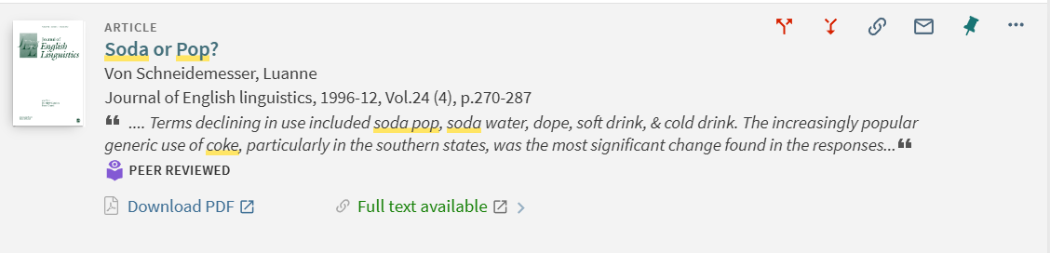
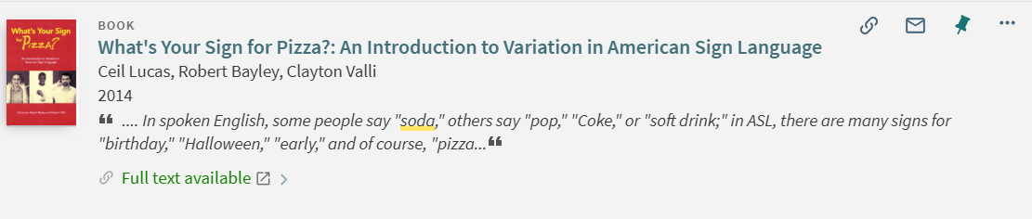
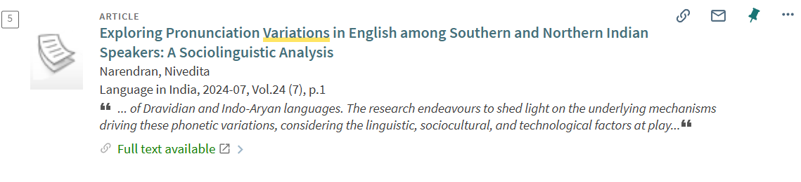
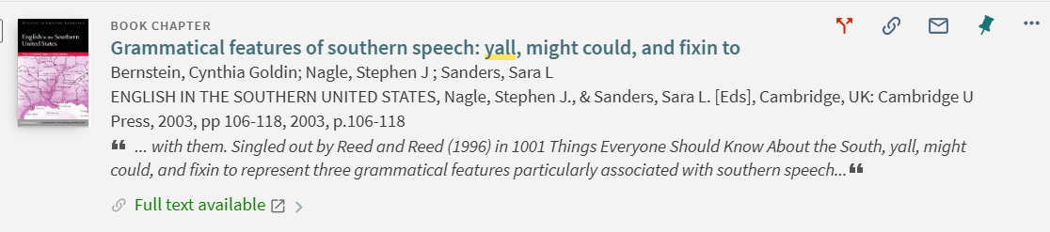
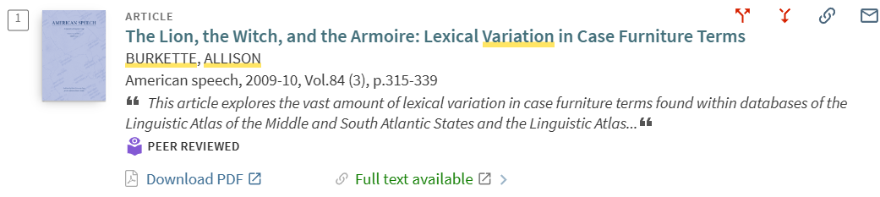
1. Based on previous research
Notes:
why important

Slide 17
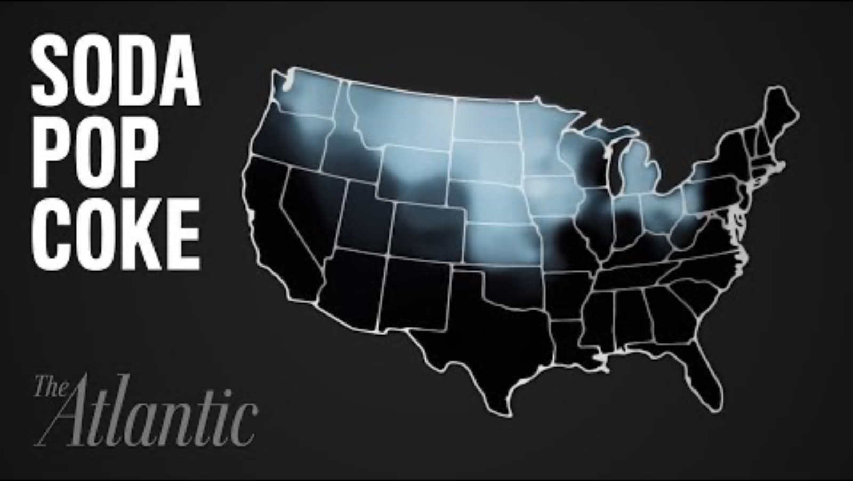
Notes:
Soda vs soder
I say it wrong, I say bag (raised /æ/), most people in minnesota do

Slide 18
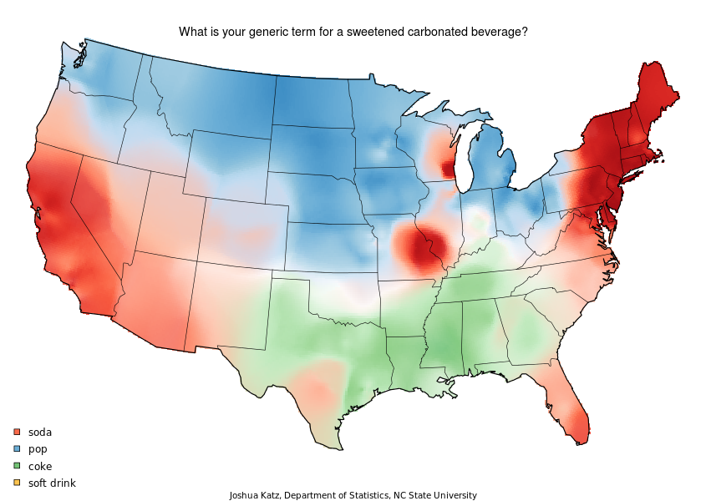
Soda
Pop
Coke
Soft drink

Slide 19

2. Practical and 3. Specific
Are there feasible methods for testing this?
If I needed to, could I use a specific method for answering?
What methods are available?
Is this narrowed enough to be doable?
Can I find methods that will let me adequately answer this question?
How much time do I have to research this question?
Would it be easier for me to answer this question if I broke it down into several smaller questions?

Slide 20

Why examine variation in words for ?
“human languages are structured systems for making articulated thoughts fully explicit both internally (mentally) and externally (in a form perceptible to other humans)” (Pullum, p. 3)
Language variation, then...
reflects historical and cultural trends
is personal and creative
is natural and “normal”
The ways we use language express information about who we are
Understanding/acknowledging others’ motivations for using language differently can make us more effective and empathetic communicators
Notes:
Coke ATL

Slide 21

What’d we talk about?
Linguistics research asks questions across a span of topics
Regional variation for lexical items = one of so many ways to answer a question about language
Appropriate research questions are
Connected to previous research
Practical and about specific topics
Questions start with observations

Slide 22
What’s next?
Wednesday: What is a word? + Pullum chapter 3 (“Words, Meaning, and Thought”)
Friday: recitation and Quiz 3
The more distant future: 2) methods of inquiry and 3) finding linguistic sources

